Slide 1

VETERINARY AND PETS MANAGEMENT SYSTEM
Here is where your presentation begins

Slide 2
Abstract
ABSTRACT
This Veterinary and Pets Management System was designed to performed in systematic through its function requirement. The management of pet shop the Showing of available products and user can add it cart .
First, the pet must be registered before having any services. Any piece of information about the pets must be correct and organized to avoid any problem to be in countered like the bad feedback from the customer.
Second, The user can book an appointment for taking insulin for pets . The user can book for the available doctor and doctor can view the appointment status and the approving the appointment.the client must register with his name,address and pet name and etc..the doctor also must also register with it.
The purpose of this system is to transact and deals with a nice and easier way by simply gathering information from the customer. It also helps to every individual by searching for the information needed.

Slide 3
DATABASE DESIGN
A database is an organized mechanism that has the capability of storing information through which a user can retrieve stored information in an effective and efficient manner. The data is the purpose of any database and must be protected.
The database design is a two level process. In the first step, user requirements are gathered together and a database is designed which will meet these requirements as clearly as possible. This step is called Information Level Design and it is taken independent of any individual DBMS.
In the second step, this Information level design is transferred into a design for the specific DBMS that will be used to implement the system in question. This step is called Physical Level Design, concerned with the characteristics of the specific DBMS that will be used. A database design runs parallel with the system design. The organization of the data in the database is aimed to achieve the following two major objectives.
Data Integrity
Data independence

Slide 4
DATABASE DESIGN
Relational Database Management System (RDBMS)
A relational model represents the database as a collection of relations. Each relation resembles a table of values or file of records. In formal relational model terminology, a row is called a tuple, a column header is called an attribute and the table is called a relation. A relational database consists of a collection of tables, each of which is assigned a unique name. A row in a tale represents a set of related values.
Relations, Domains & Attributes
A table is a relation. The rows in a table are called tuples. A tuple is an ordered set of n elements. Columns are referred to as attributes. Relationships have been set between every table in the database. This ensures both Referential and Entity Relationship Integrity. A domain D is a set of atomic values. A common method of specifying a domain is to specify a data type from which the data values forming the domain are drawn. It is also useful to specify a name for the domain to help in interpreting its values.
Every value in a relation is atomic, that is not decomposable.

Slide 5
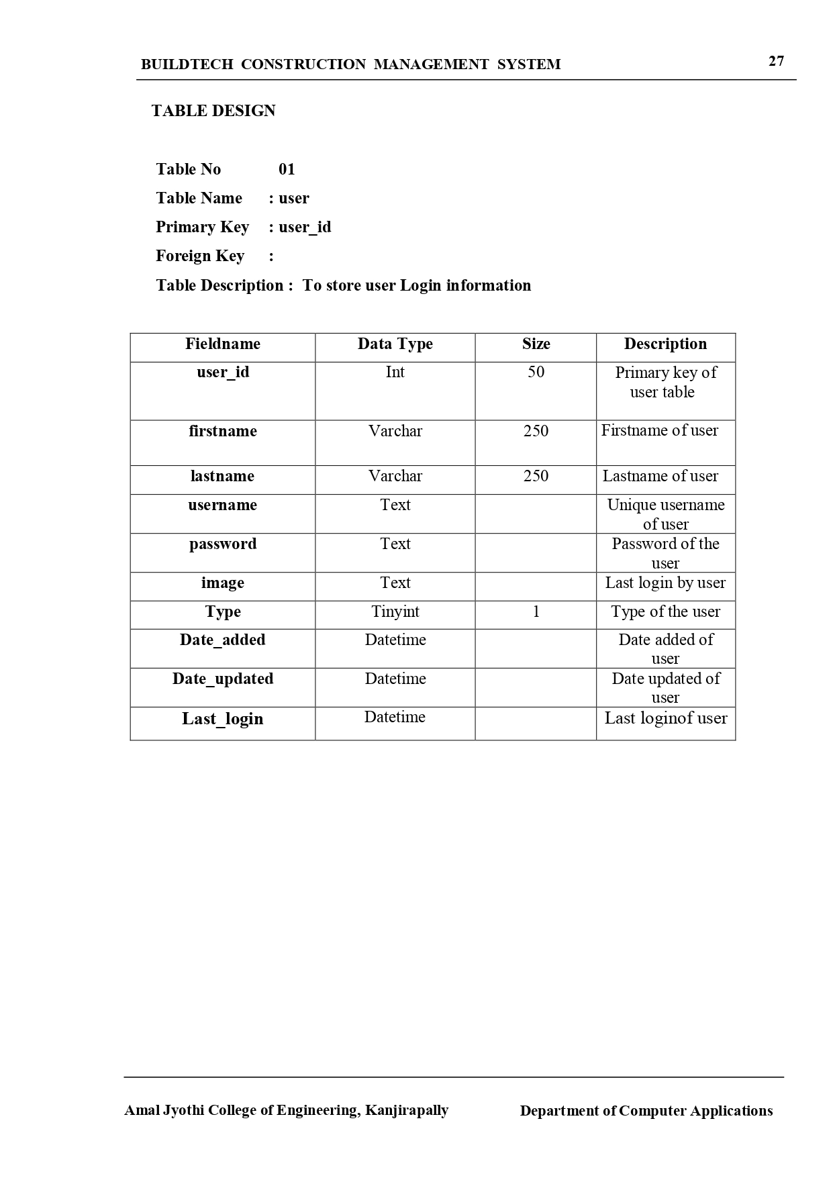
TABLE DESIGN

Slide 6
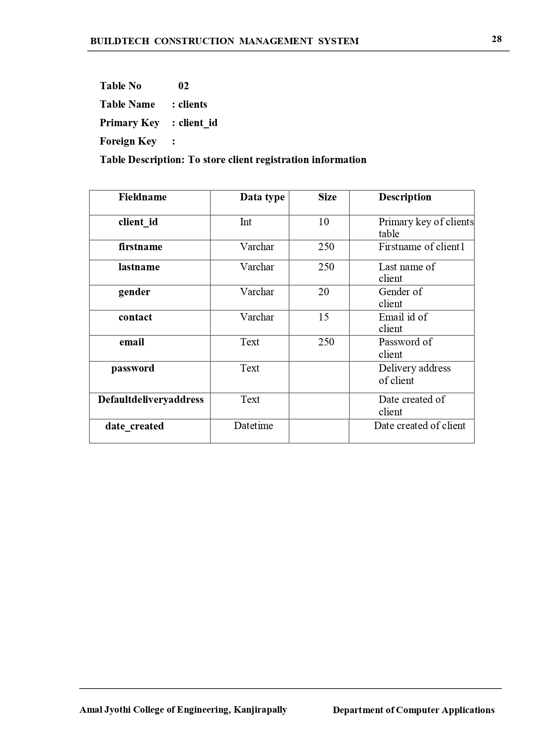
TABLE DESIGN

Slide 7
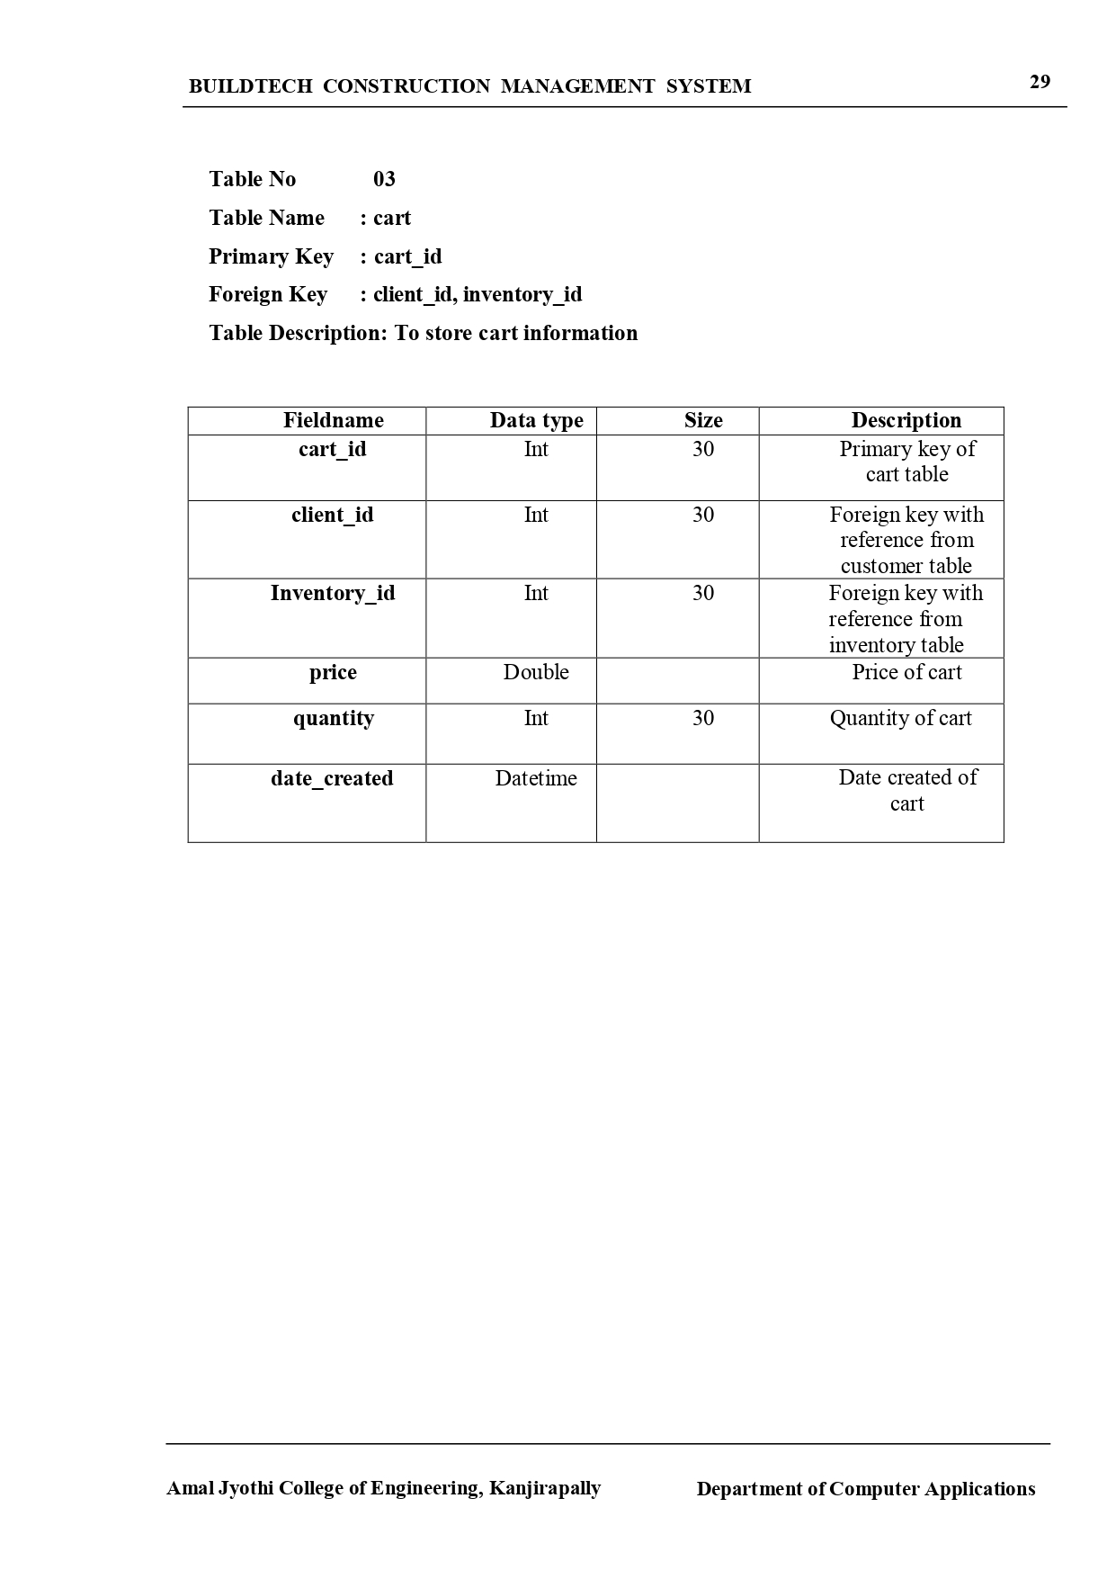
TABLE DESIGN

Slide 8
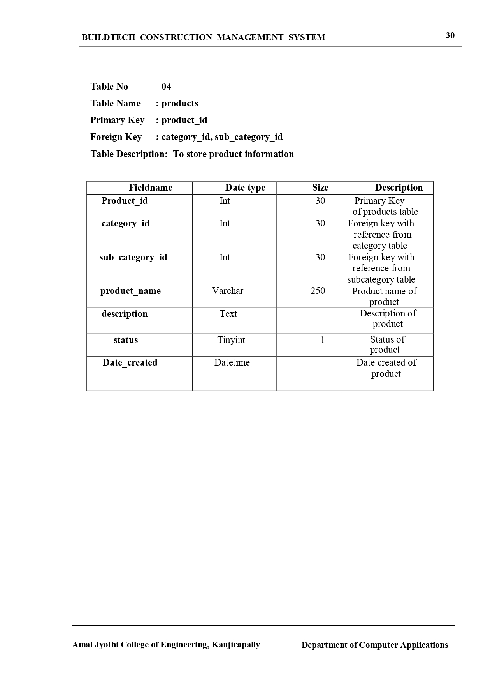
TABLE DESIGN

Slide 9
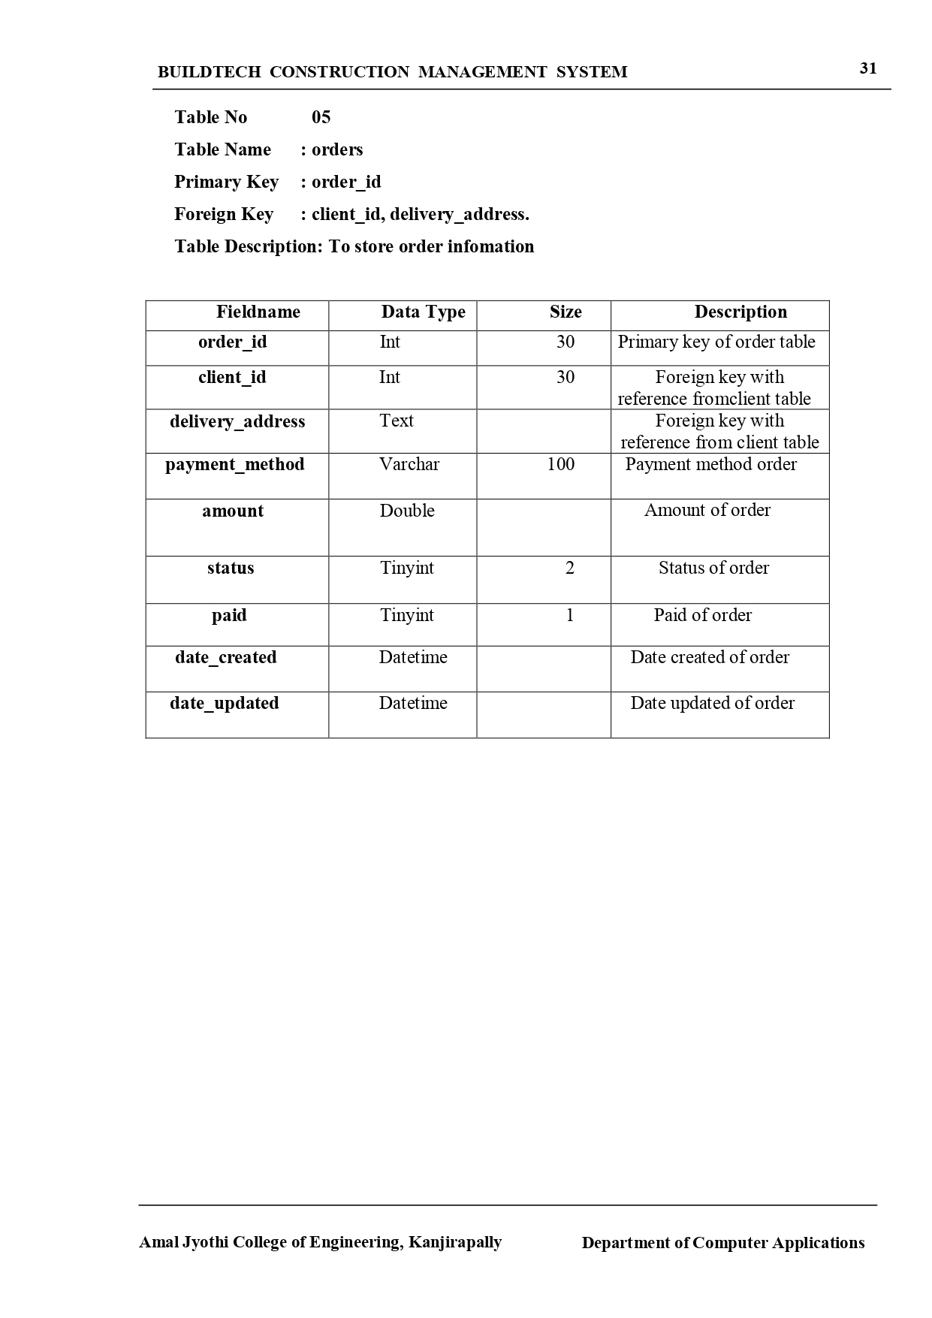
TABLE DESIGN

Slide 10
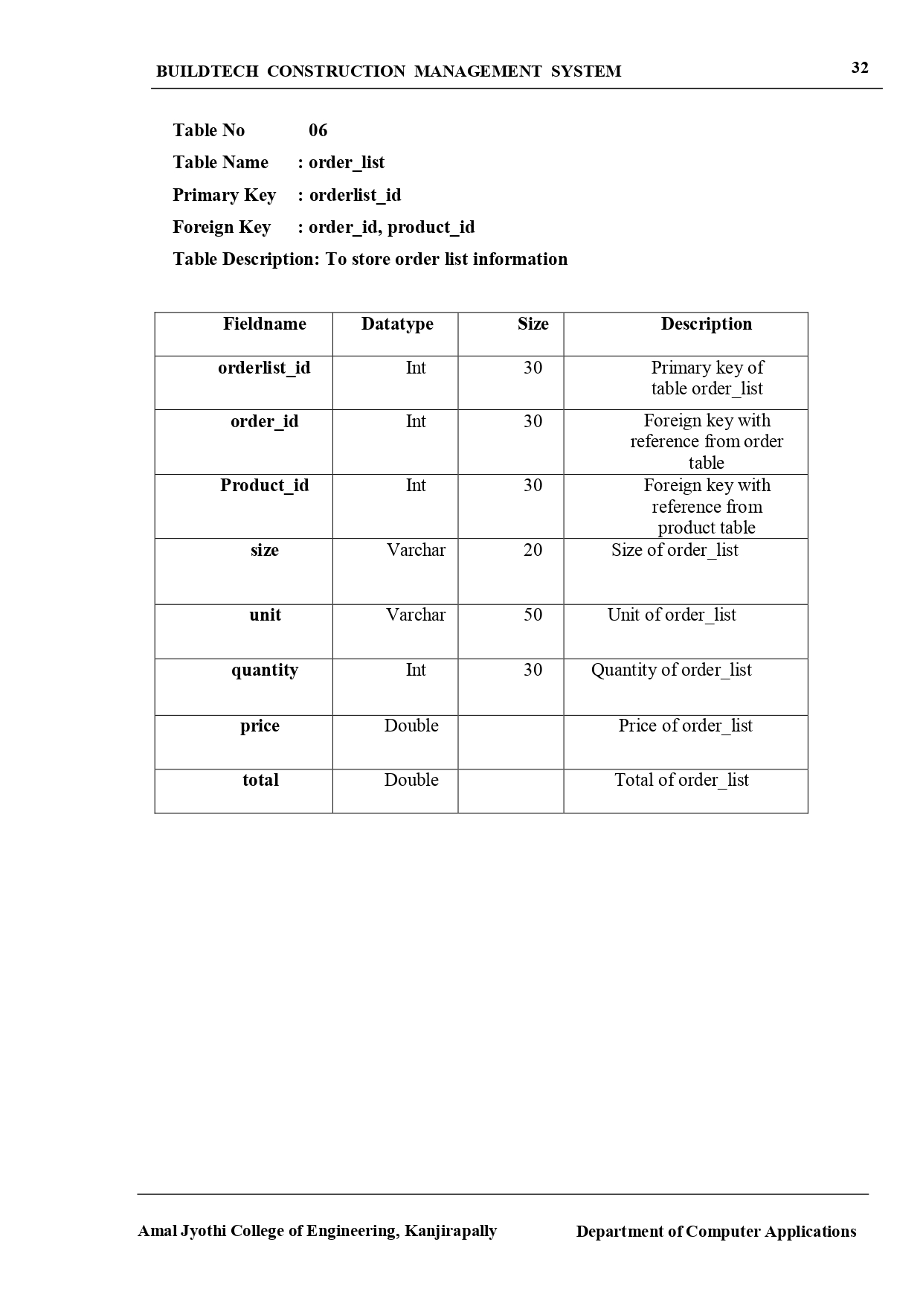
TABLE DESIGN

Slide 11
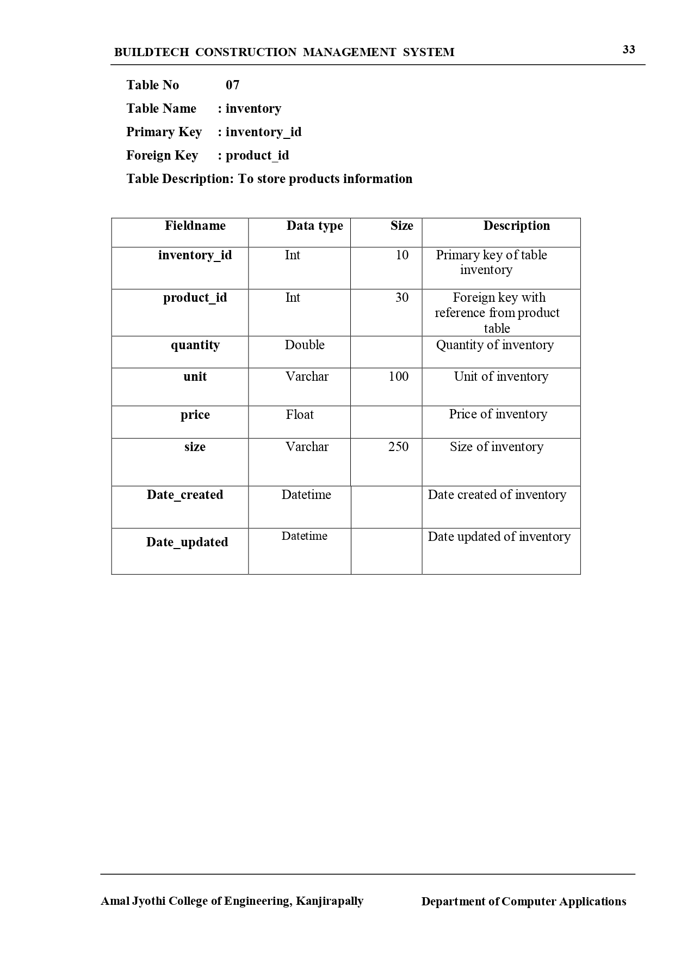
TABLE DESIGN

Slide 12
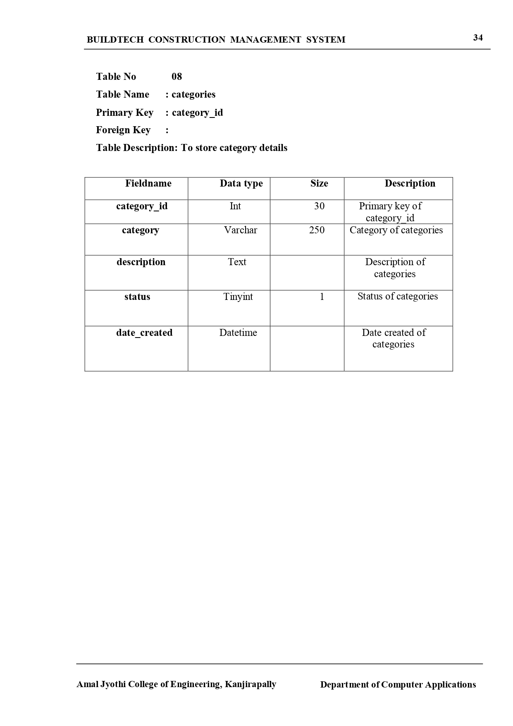
TABLE DESIGN

Slide 13
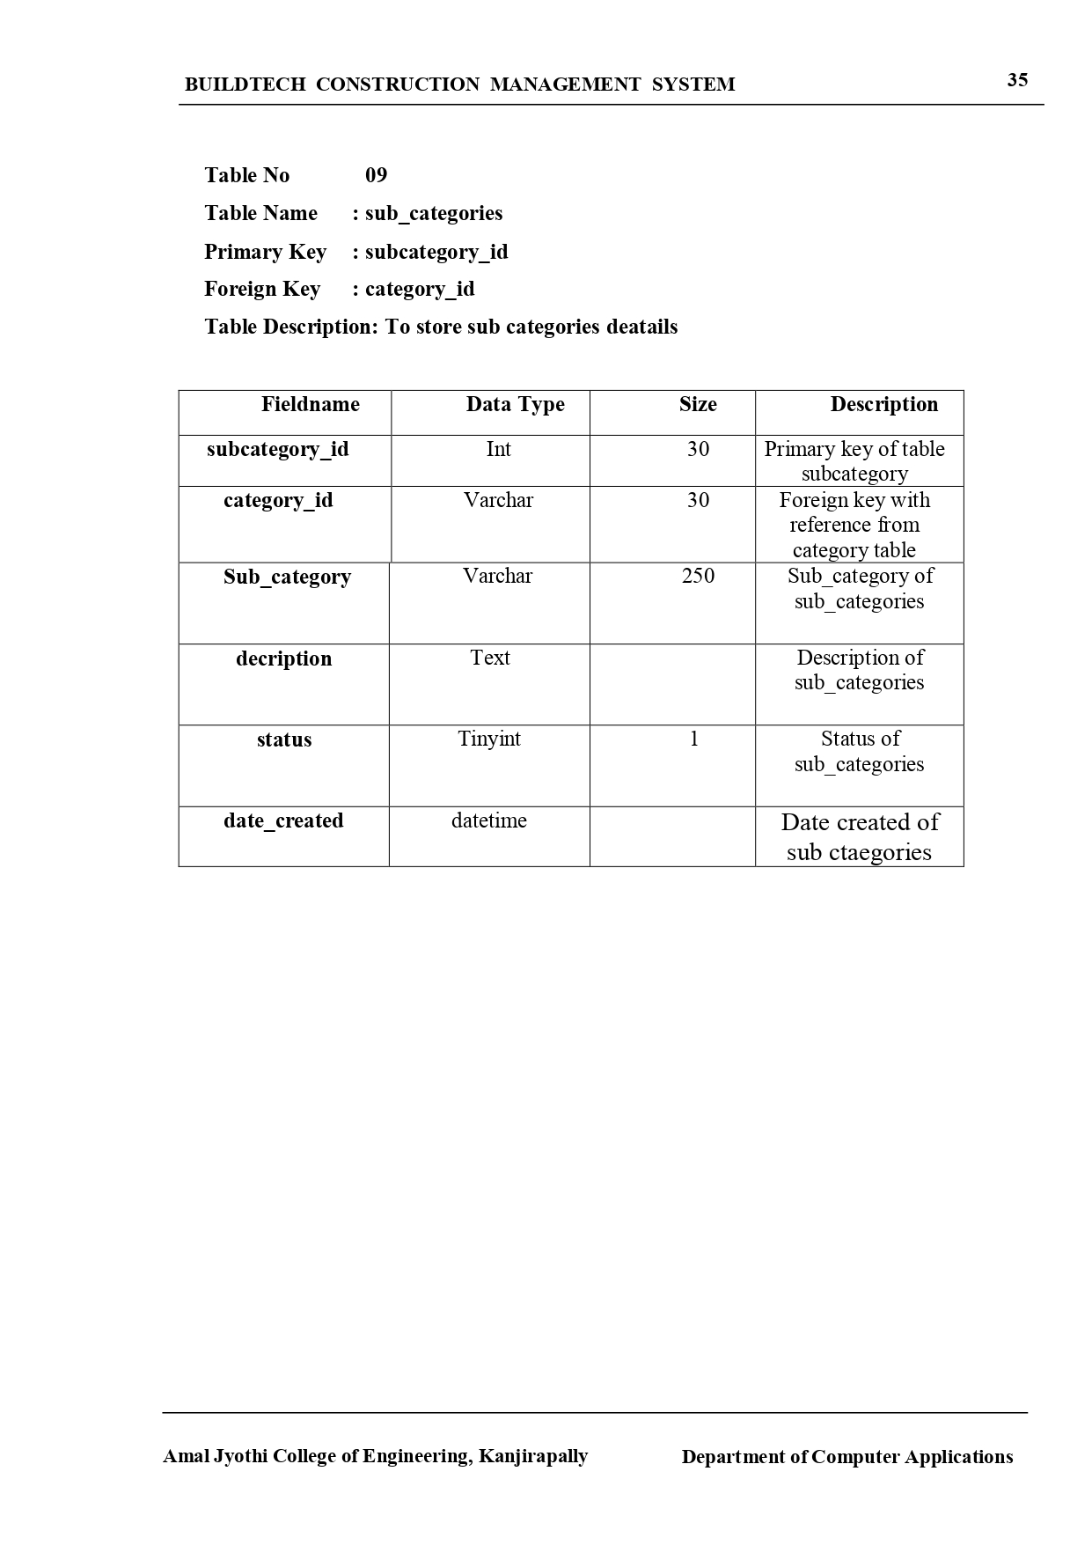
TABLE DESIGN

Slide 14
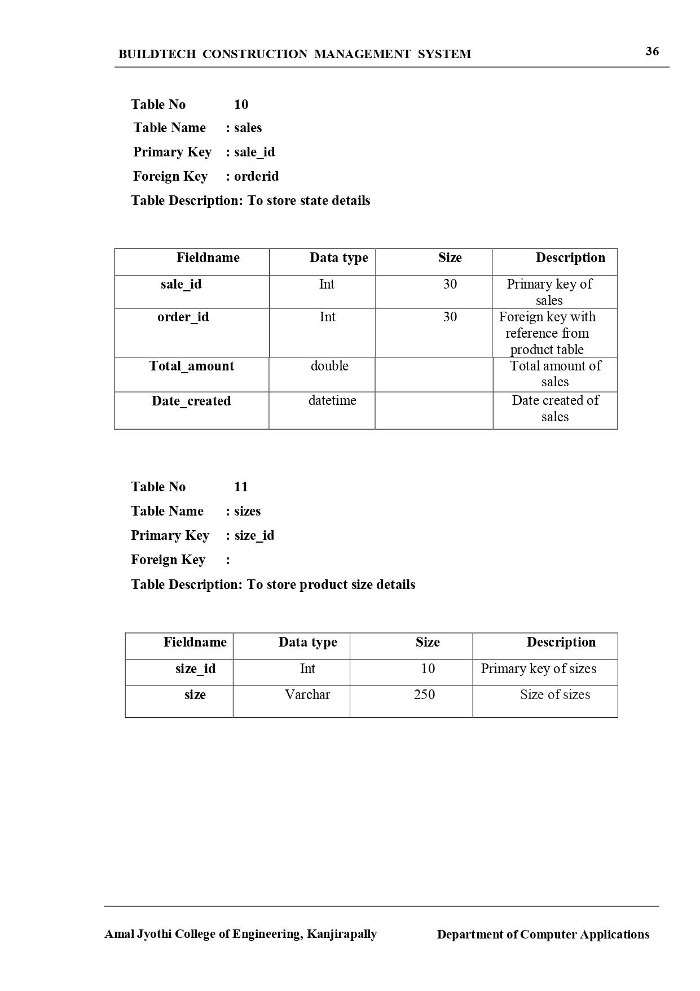
TABLE DESIGN

Slide 15
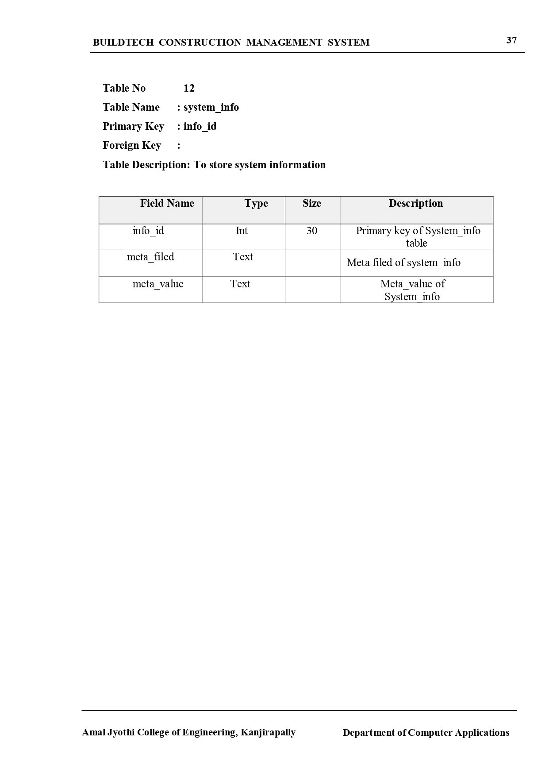
TABLE DESIGN

Slide 16
UML DIAGRAMS

Slide 17
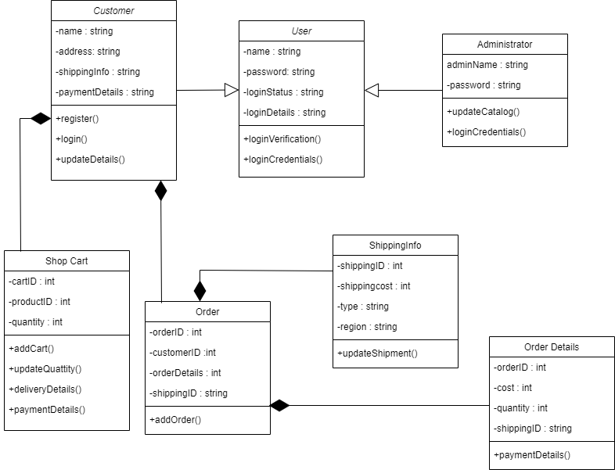
CLASS DIAGRAM

Slide 18
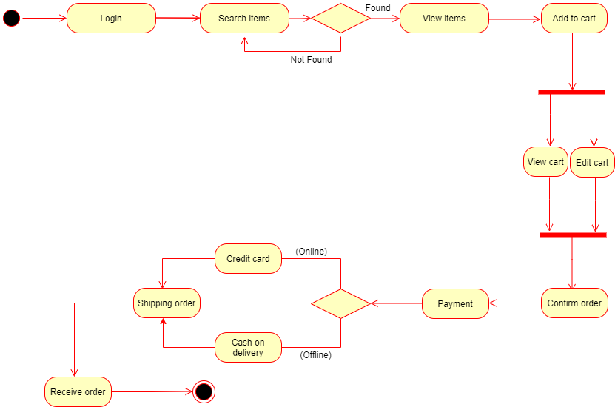
ACTIVITY DIAGRAM

Slide 19
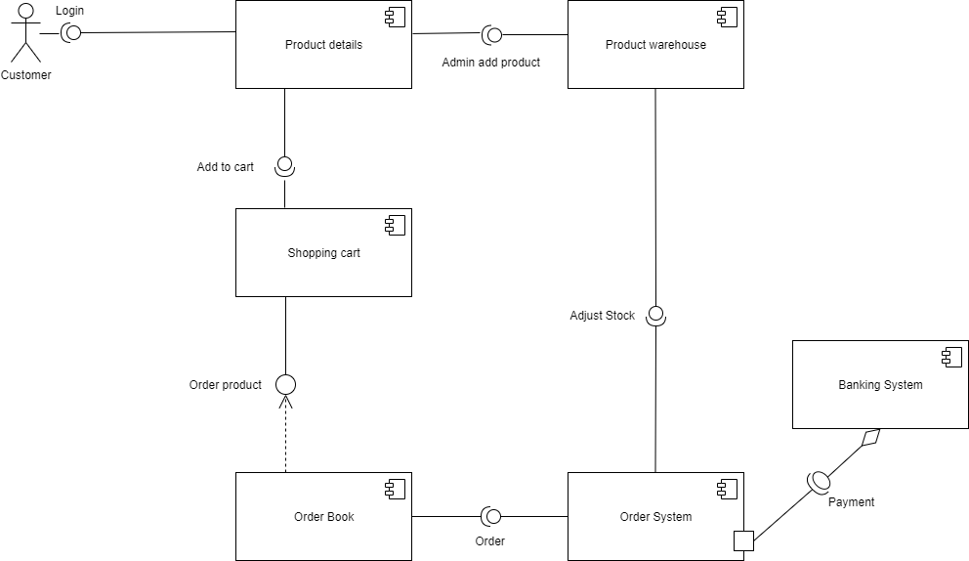
COMPONENT DIAGRAM

Slide 20
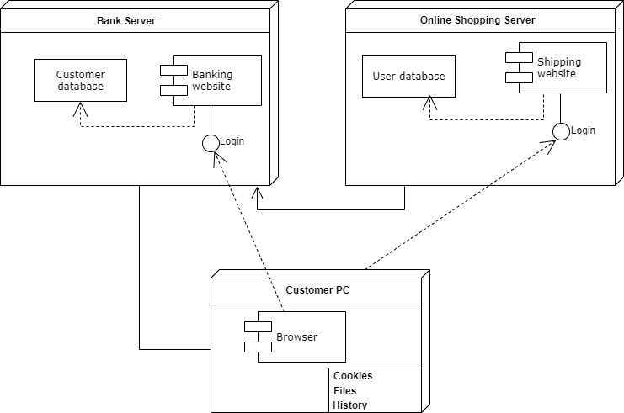
DEPLOYEMENT DIAGRAM

Slide 21
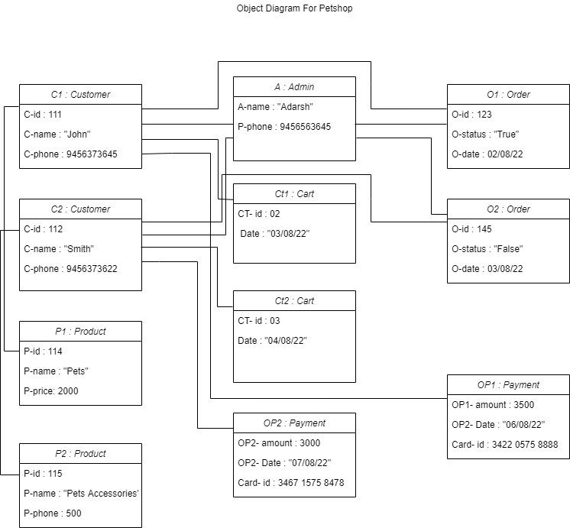
OBJECT DIAGRAM

Slide 22
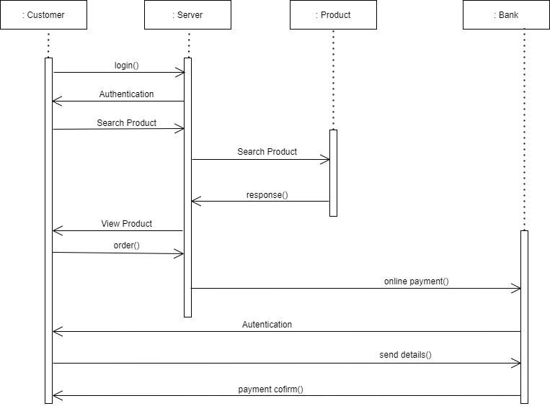
SEQUENCE DIAGRAM

Slide 23
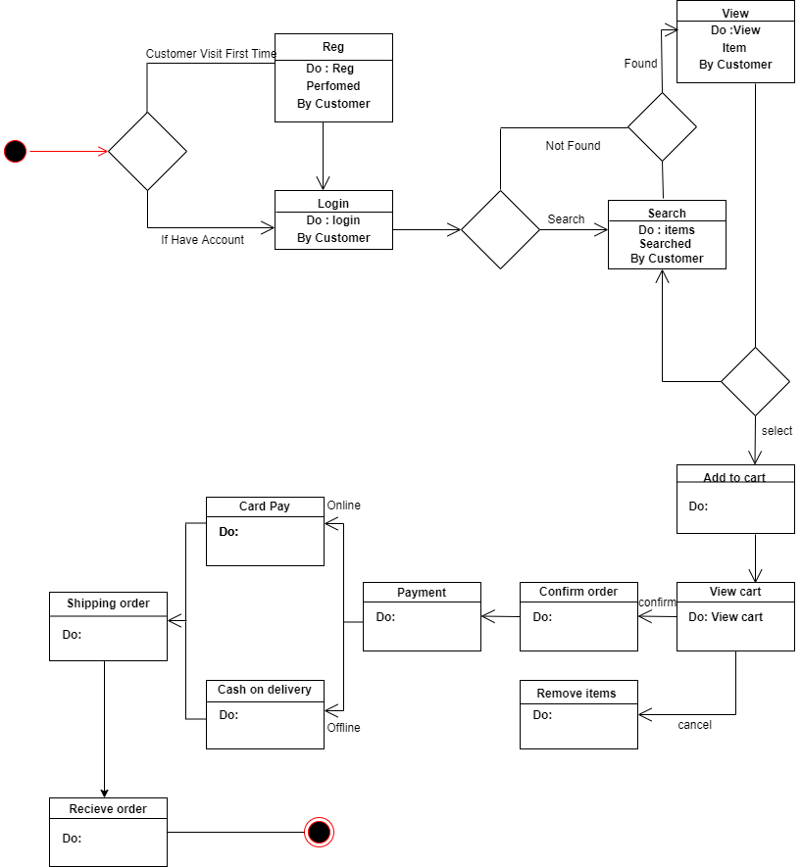
STATE DIAGRAM

Slide 24
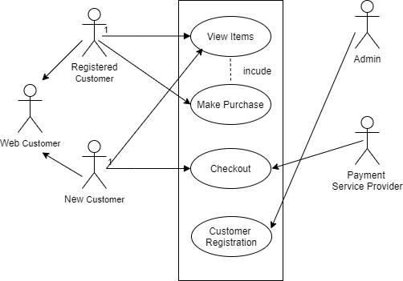
USECASE DIAGRAM

Slide 25
USECASE DIAGRAM

Slide 26
PROTOTYPE USING FIGMA

Slide 27
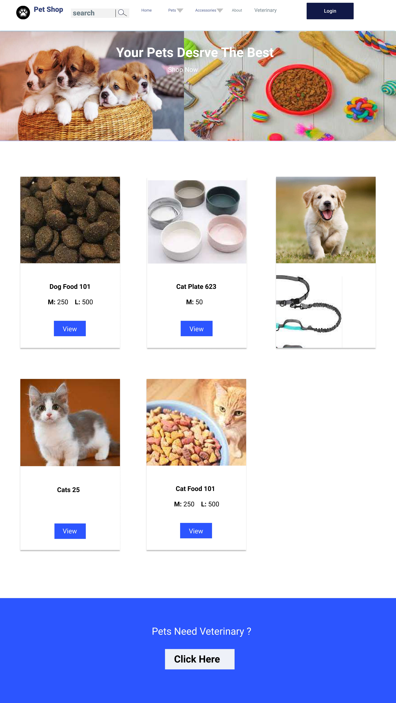
.

Slide 28
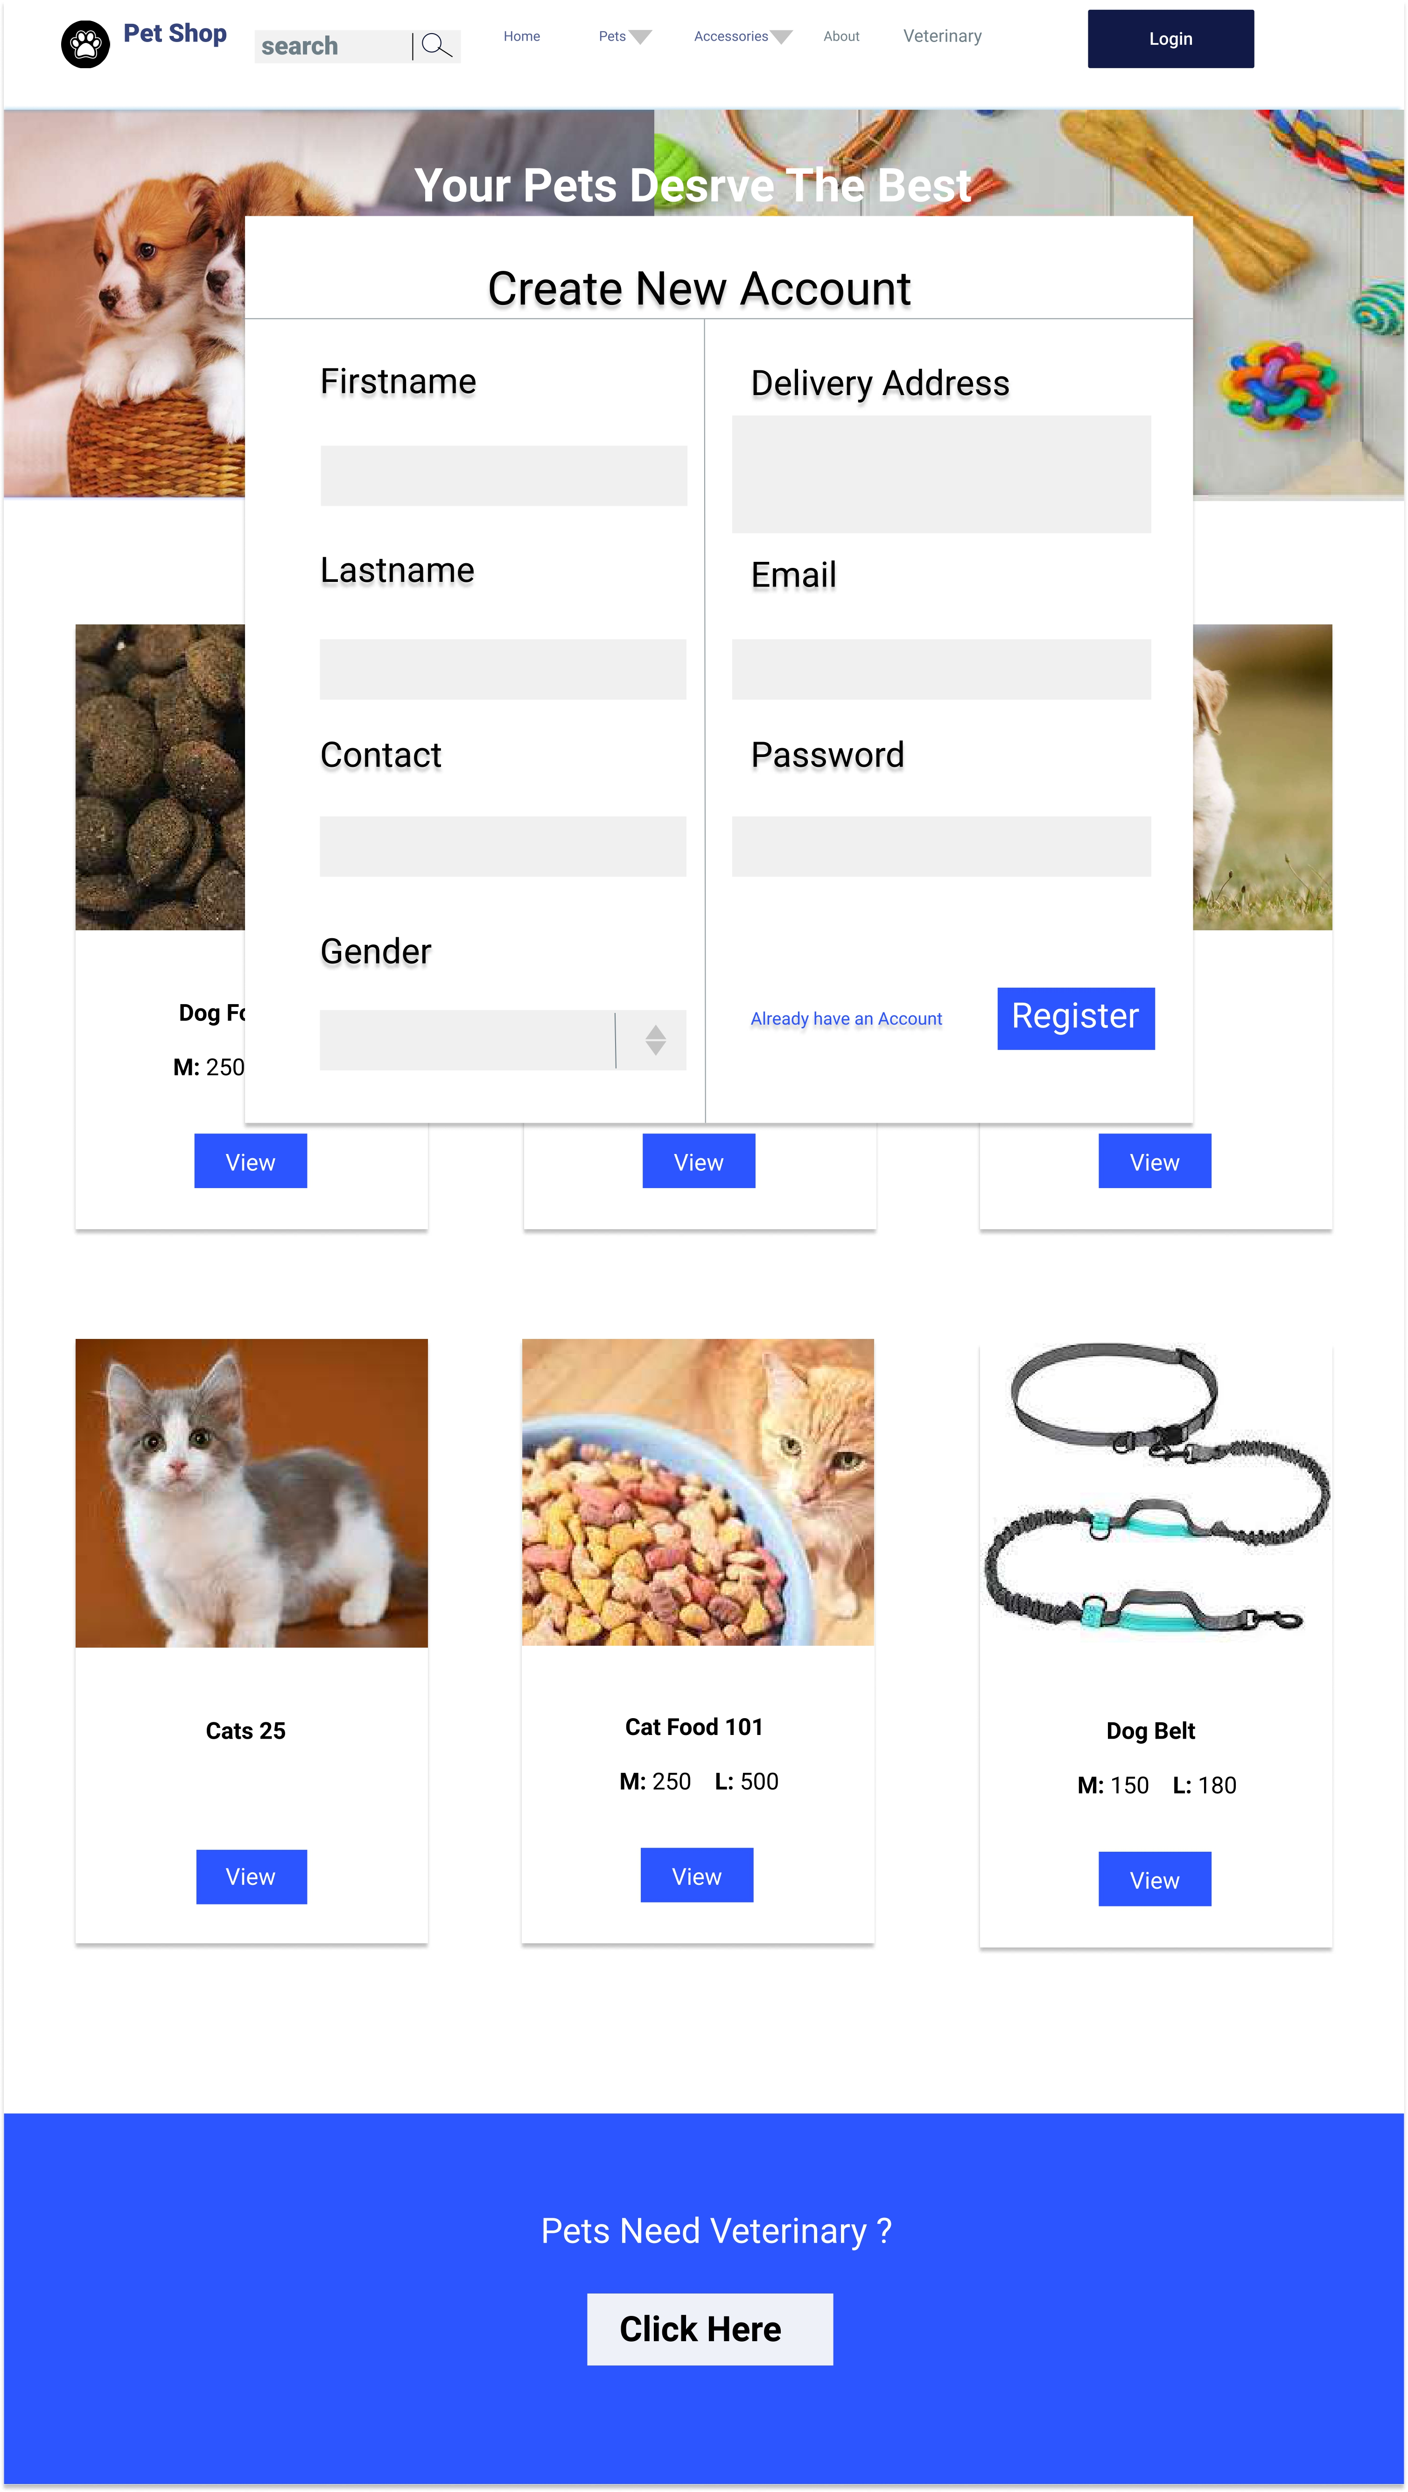
.

Slide 29



